Slide 1


Active Learning for 3D Human Pose Estimation:
Combining the Strategies of Uncertainty and Diversity
主動學習機制應用於三維人體骨架預測:
結合不確定性與多樣性策略
Yi-Yun Hsieh (謝宜芸)
Advising Professor: Min-Chun Hu (胡敏君 教授)
National Tsing Hua University

Slide 2
Outline
1
1
Introduction
4
1
Experimental Results
2
1
Related work
5
1
Conclusions
3
1
Proposed Method

Slide 3
Background
Motivation
Contribution
Introduction

Slide 4

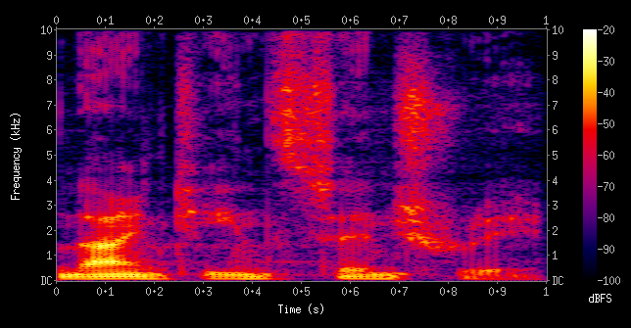
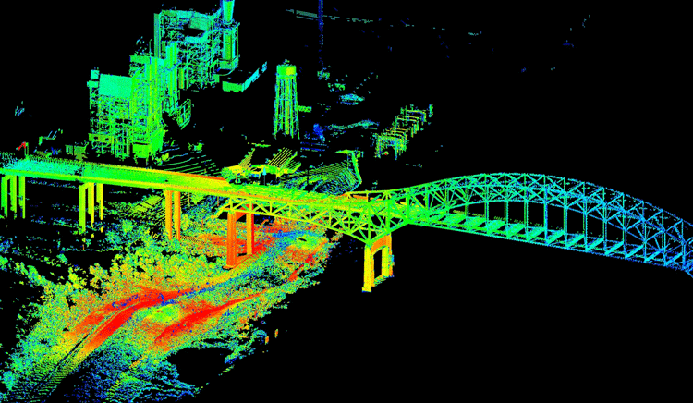
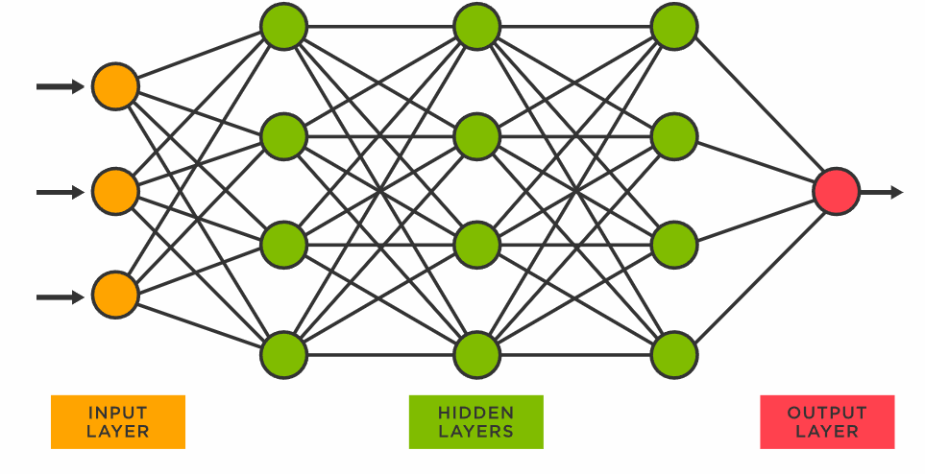
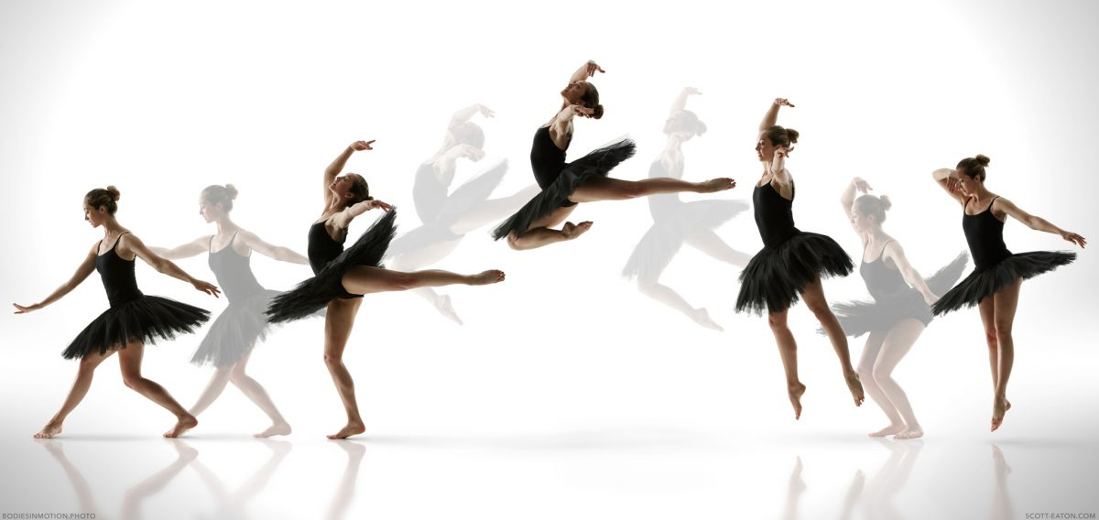



Background
Standard supervised learning pipeline
Data and its labels
Model/Network
Text
Audio
Sensor
Video
Image
Survey

Slide 5
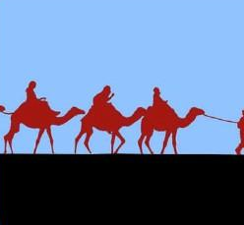
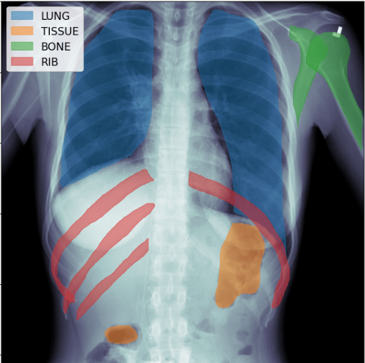
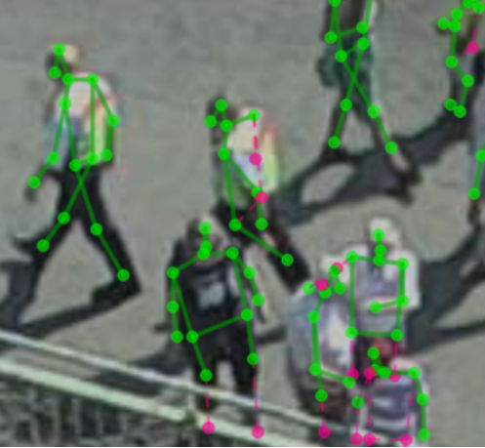



Problem - Data Annotation
Annotating unlabeled dataset is time-consuming and costly.
Annotation Time: 44.1 seconds per 2D pose and bounding box.[1]
Annotate
Pixel-level -> difficult
Expert-> money
Consume human resource
Video
Image
Pixel-level
Expert
Time-consuming
[1]Interactive Labeling for Human Pose Estimation in Surveillance Videos

Slide 6

Problem - Data Annotation
Annotating unlabeled dataset is time-consuming and costly.
Annotation Time: 44.1 seconds per 2D pose and bounding box.[1]
Therefore, it is important to
Build a practical system to annotate data efficiently.
Reduce the annotation costs.
Annotate
Pixel-level -> difficult
Expert-> money
Consume human resource
Video
Image
Pixel-level
Expert
Time-consuming
[1]Interactive Labeling for Human Pose Estimation in Surveillance Videos(ICCV 2021)

Slide 7
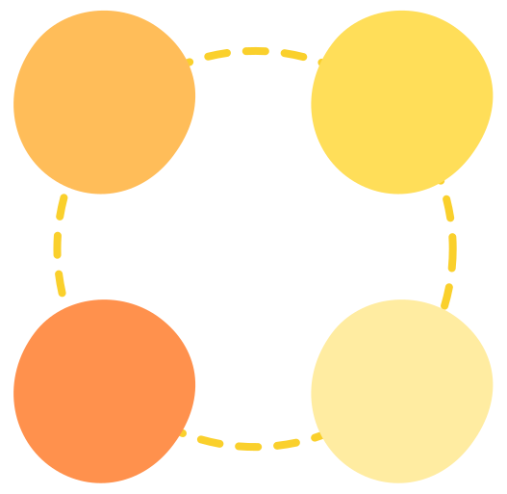

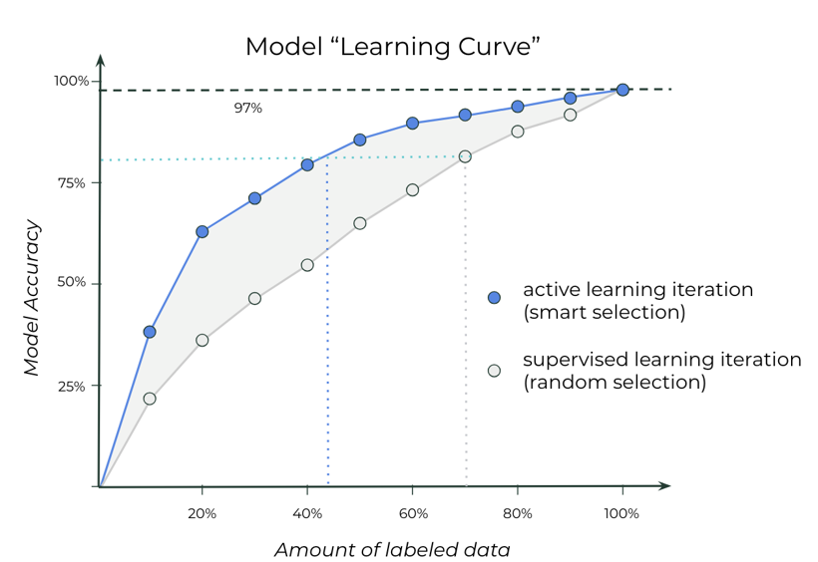
Motivation - Active learning
Goal
Query the most informative or useful unlabeled data to annotate.
Annotated dataset begins with small and iteratively grows in size.
Higher accuracy with less data annotation.
Data 1
Data 2
Train the models
Select the data
Data 1
Data 2
Query
Use selection policy to
select the next sample
Label
Label the selected data
Query
Label
Active Learning Loop
Train
Train the model based on training dataset
Enrich
Add newly labeled data to the training dataset
Train the models
Select the data
Train
Enrich

Slide 8
Motivation - Active learning
Goal
Query the most informative or useful unlabeled data to annotate.
Annotated dataset begins with small and iteratively grows in size.
Higher accuracy with less data annotation.
Data 1
Data 2
Train the models
Select the data
Data 1
Data 2
Train the models
Select the data

Slide 9
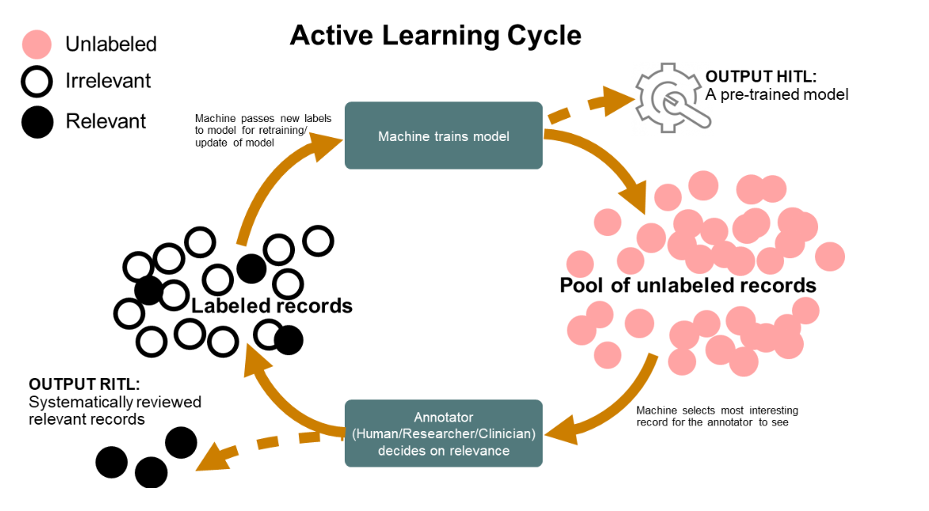
Motivation - Active learning
Goal
Query the most informative or useful unlabeled data to annotate.
Annotated dataset begins with small and iteratively grows in size.
Higher accuracy with less data annotation.
Criteria
Uncertainty
Diversity
Data 1
Data 2
Train the models
Select the data
Data 1
Data 2
Train the models
Select the data

Slide 10
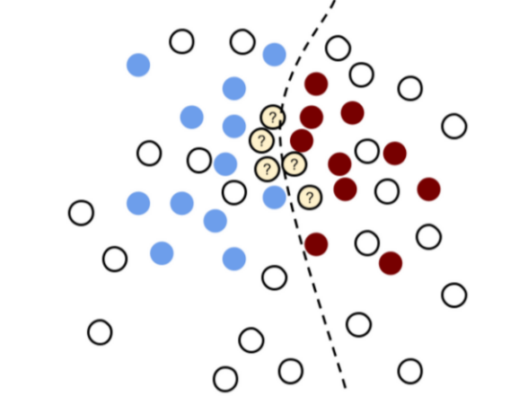
Motivation - Active learning
Decision boundary
Goal
Query the most informative or useful unlabeled data to annotate.
Annotated dataset begins with small and iteratively grows in size.
Higher accuracy with less data annotation.
Criteria
Uncertainty
Select the high uncertainty data points.
For example, data with high entropy.
Diversity
Data 1
Data 2
Train the models
Select the data
Data 1
Data 2
Yellow data tends to predict wrongly from the model.
Train the models
Select the data

Slide 11
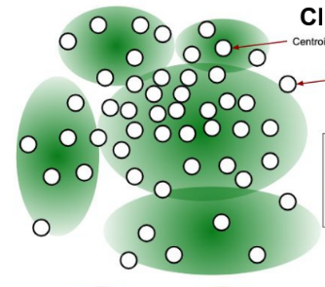
Motivation - Active learning
Goal
Query the most informative or useful unlabeled data to annotate.
Annotated dataset begins with small and iteratively grows in size.
Higher accuracy with less data annotation.
Criteria
Uncertainty
Select the high uncertainty data points.
For example, data with high entropy.
Diversity
Select the data points that represent the whole distribution of the unlabeled dataset.
For example, the center of clustering.
?
?
?
?
?
?

Slide 12
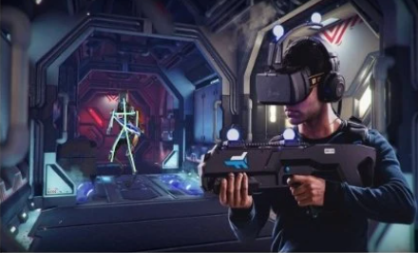
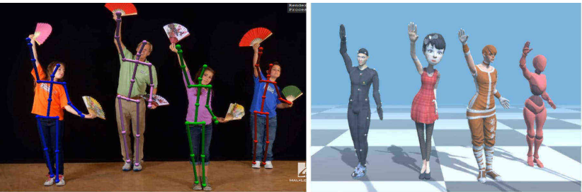
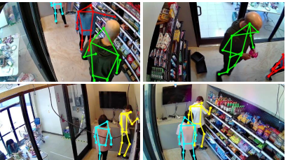
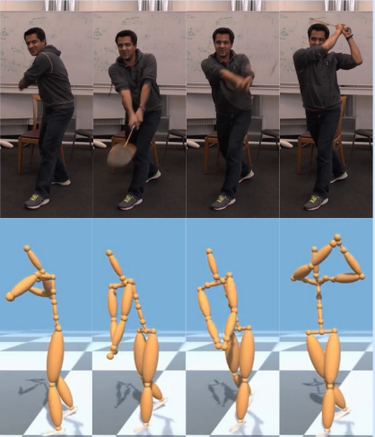
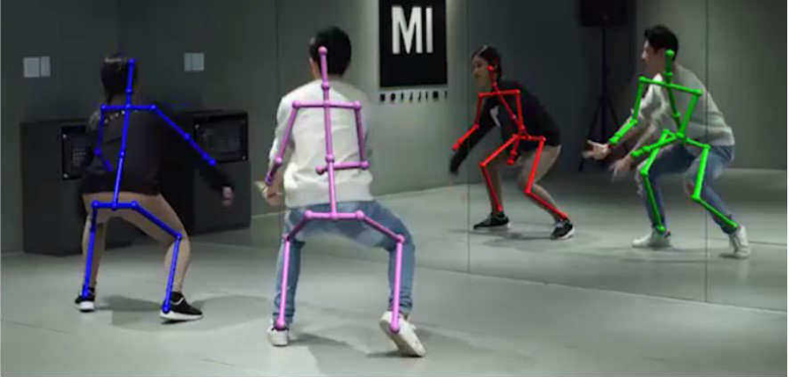
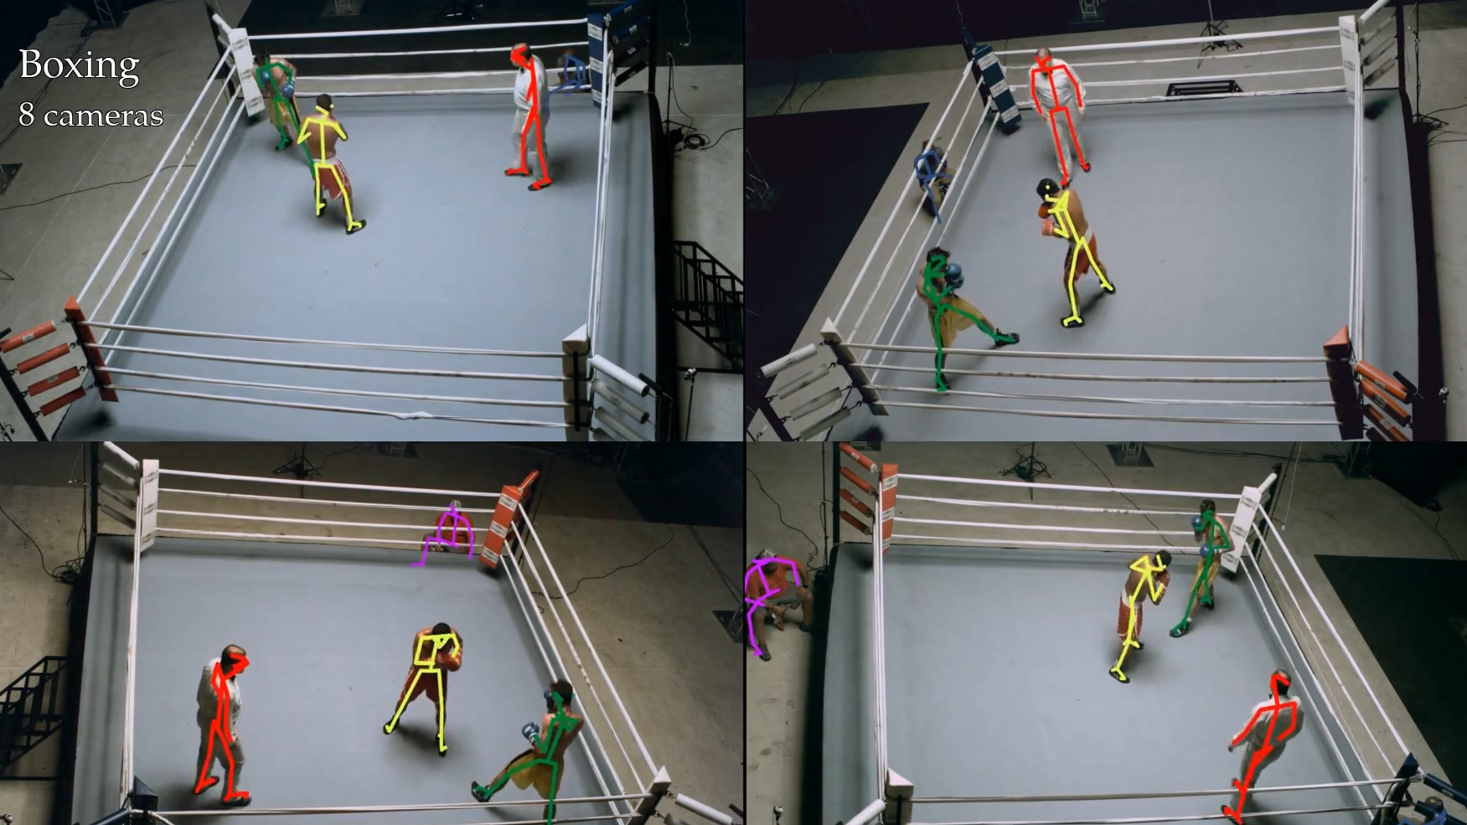
Motivation
3D human pose estimation is widely used in many applications.
Game
Smart surveillance
Sports analysis
3D data collection problems
Limited equipment
Missing markers(VICON - Replace Missing Marker)
We want to apply active learning method on 3D human pose estimation.
Train our 3D pose model with small training dataset.
No need to label unnecessary frames.

Slide 13
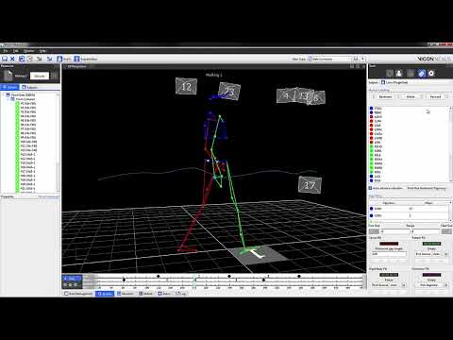
Motivation
3D human pose estimation is widely used in many applications.
Game
Smart surveillance
Sports analysis
3D data collection problems
Limited equipment
Missing markers(VICON - Replace Missing Marker)
We want to apply active learning method on 3D human pose estimation.
Train our 3D pose model with small training dataset.
No need to label unnecessary frames.

Slide 14
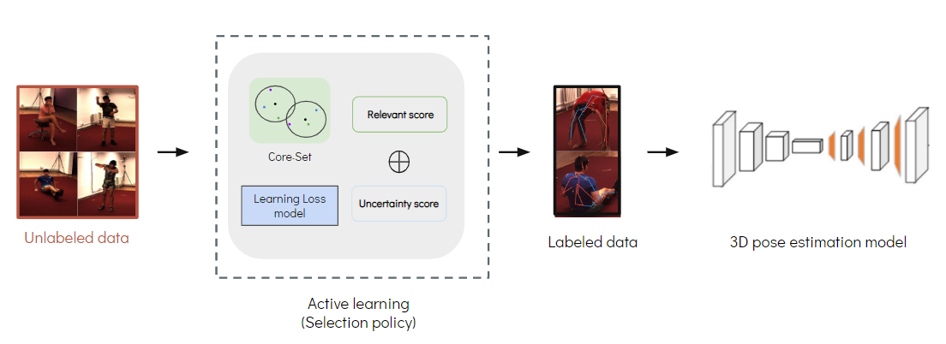
Goals & Contributions
We propose an active learning framework for monocular 3D human pose estimation task.
Combine uncertainty and diversity into a hybrid strategy.
Our approach achieves the best and second-best performance at different active learning stages.
A small number of training dataset with maximize performance.
Apply our approach on two scenarios (這邊的話, 不太清楚定義是什麼)
Scenario A observes the improvement of active learning in 3D pose model.
Scenario B investigates into real world issues
Add new dataset based on existing public dataset.
The improvement of active learning in 2D and 3D pose models.

Slide 15
Uncertainty-based method
Diversity-based method
Summary of Related Work
Related work

Slide 16
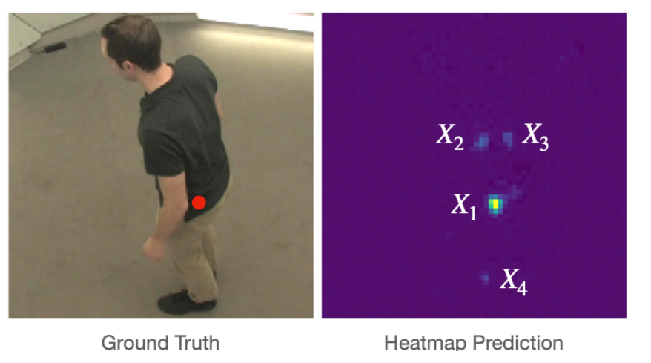
Uncertainty-based method
Multiple Peak Entropy (MPE) [1]
Multiple local peaks in the 2D heatmap.
Local peaks*4
[1] Liu and Ferrari. Active learning for human pose estimation (ICCV 2017)

Slide 17
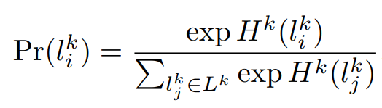
Uncertainty-based method
Multiple Peak Entropy (MPE) [1]
Multiple local peaks in the 2D heatmap.
Normalize all local peaks with softmax function.
Local peaks*4
[1] Liu and Ferrari. Active learning for human pose estimation (ICCV 2017)

Slide 18
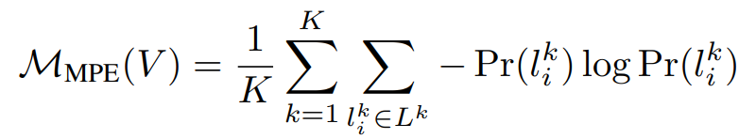
Uncertainty-based method
Multiple Peak Entropy (MPE) [1]
Multiple local peaks in the 2D heatmap.
Normalize all local peaks with softmax function.
View entropy as uncertainty score.
Local peaks*4
[1] Liu and Ferrari. Active learning for human pose estimation (ICCV 2017)

Slide 19
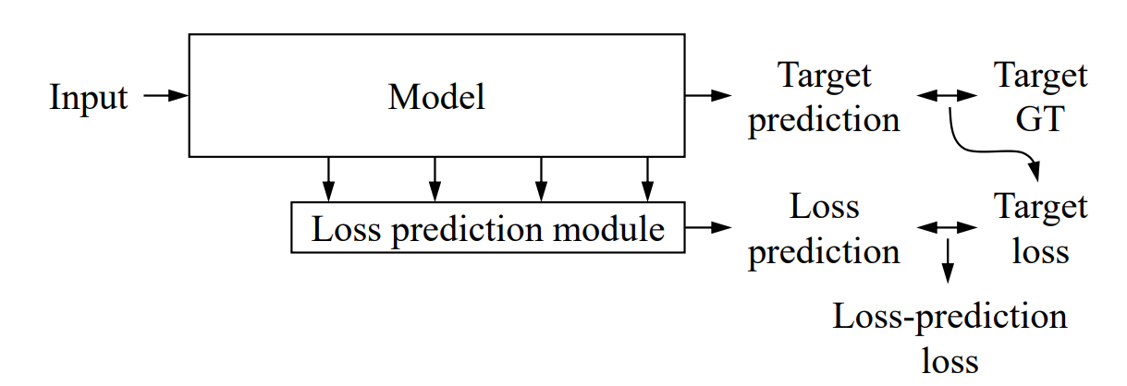
Uncertainty-based method
Learning Loss [1]
Utilize training loss as uncertainty -> High training loss means high uncertainty.
Design loss prediction module to predict the training loss of the target model.
Learning Loss++
L (scaled) 因為learning loss target loss會隨著
[1] Yoo and Kweon. Learning Loss for Active Learning. (CVPR 2019) [2] Megh and Shuaib. A Mathematical Analysis of Learning Loss for Active Learning in Regression (CVPR 2021)

Slide 20
Uncertainty-based method
Learning Loss [1]
Utilize training loss as uncertainty -> High training loss with high uncertainty.
Design loss prediction module to predict the training loss of the target model.
Learning loss ++ [2]
Original: Rank the training loss in each epoch with hyper-parameter.
Optimized: Normalize the training loss in each epoch with KL-divergence.
Learning Loss++
L (scaled) 因為learning loss target loss會隨著
[1] Yoo and Kweon. Learning Loss for Active Learning. (CVPR 2019) [2] Megh and Shuaib. A Mathematical Analysis of Learning Loss for Active Learning in Regression (CVPR 2021)

Slide 21
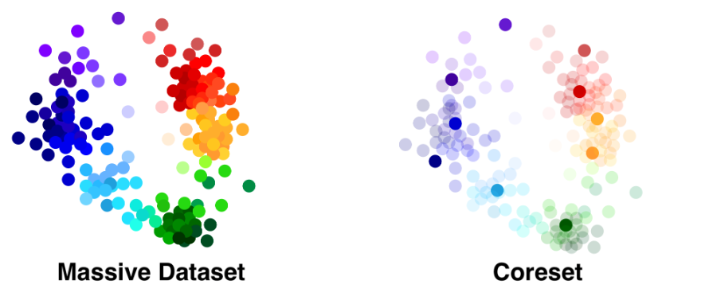
Diversity-based method
Core-Set [1]
Representative data point of class green
[1] Active Learning for Convolutional Neural Networks: A Core-Set Approach (ICLR 2018)

Slide 22
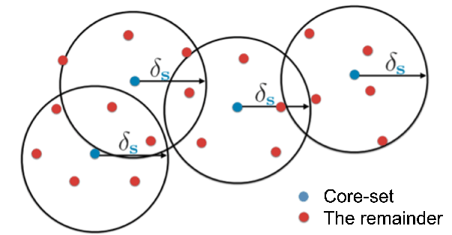
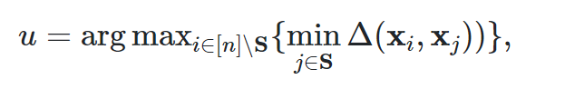
Diversity-based method
Core-Set [1]
Labeled data as center.
Calculate the distance between labeled data and unlabeled data -> Similarity.
Find the furthest unlabeled data -> Enhance the diversity of training dataset.
Representative data point of class green
[1] Active Learning for Convolutional Neural Networks: A Core-Set Approach (ICLR 2018)

Slide 23
Imbalance in the top-K samples.
Pros & Cons
Method | Pros | Cons
Uncertainty-based | Allow the model chooses what it wants to learn, thus increasing the dataset’s informativeness. | Choose a set of high-information but similar data.
Diversity-based | Find the high influence data of unlabeled dataset. | Lose the chance of selecting the hard data.
Our work
Takes uncertainty and diversity into consideration for 3D human pose estimation.
Enriches the training dataset with information-rich and representative data simultaneously.

Slide 24
Proposed Method
Overview
Training stage - Task model
Loss function
Active learning - Selection Policy

Slide 25
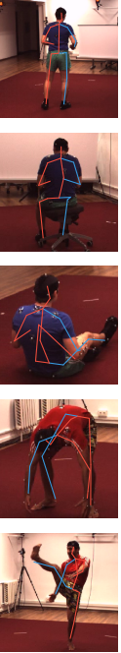
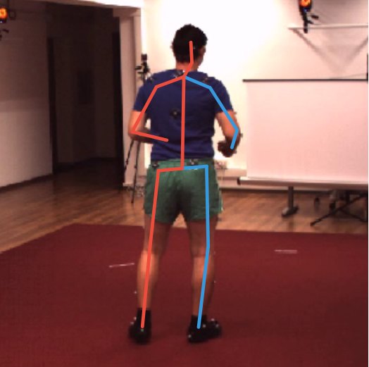
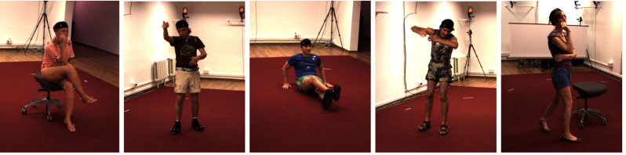
Overview
Training stage
Query top-2K data
Query top-2K data
2D pose model
3D pose model
Loss prediction
module
Labeled data
Loss prediction
module
Active learning
Labeled 2D feature
δ
Labeled data
2D pose model
Relevant
Score
Loss prediction
module
Uncertainty
Score
Unlabeled 2D feature
Core-Set
Unlabeled subset
Unlabeled data
Query top-K data

Slide 26
Overview
Training stage
Query top-2K data
Query top-2K data
2D pose model
3D pose model
Loss prediction
module
Labeled data
Loss prediction
module

Slide 27
Inspiration - Loss prediction module
Design our loss prediction module by following the steps:
Input: hidden layers of task model.
Output: loss prediction module predicts the loss prediction
GT: training loss of task model.
Task model

Slide 28
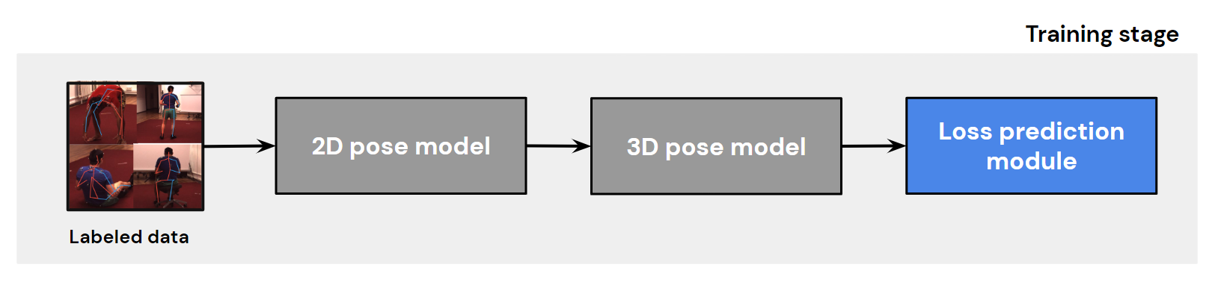
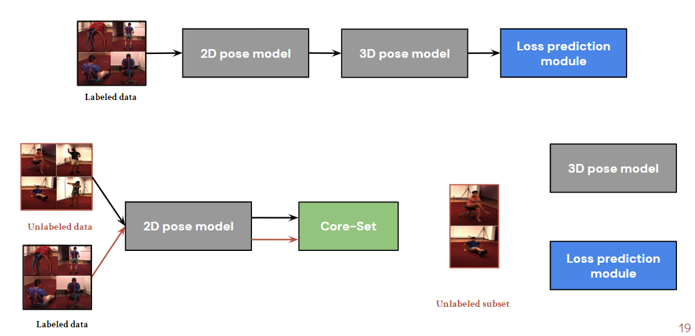
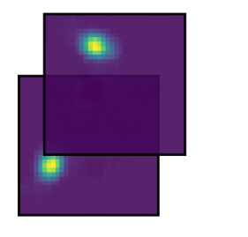
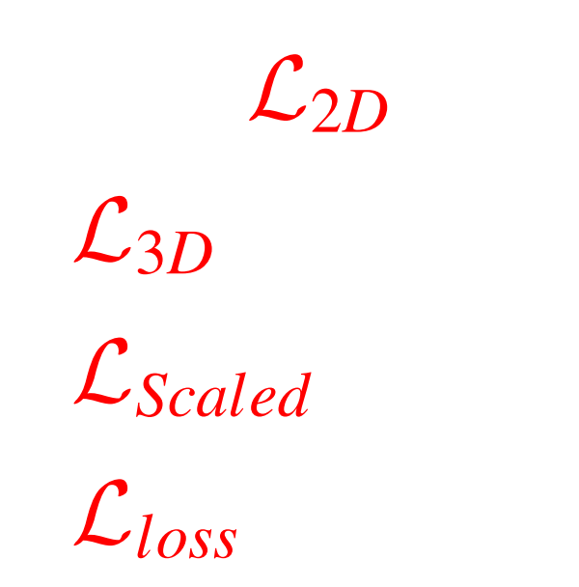
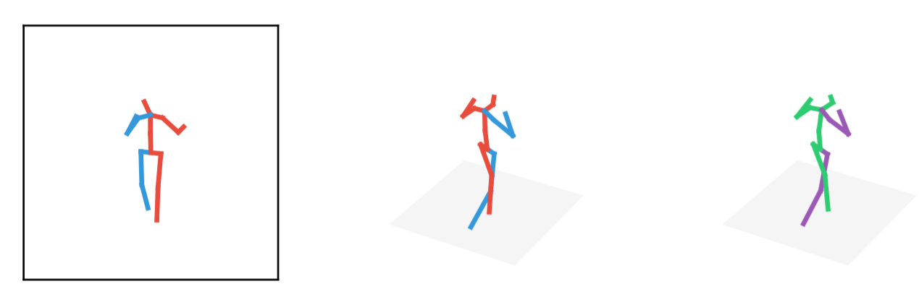
2D gaussian ground-truth heatmap
(16 x 64 x 64)
Training stage
Residual block
Hourglass
concat
Convolution
Batch nor + RELU + Dropout
Max pooling
Sigmoid
2D Stacked Hourglass model
x2
Avg
Argmax
Image
(256 x 256)
2D predicted heatmap
(16 x 64 x 64)
2D Prediction
(17 x 2)

Slide 29
2D gaussian ground-truth heatmap
(16 x 64 x 64)
Training stage
Residual block
Hourglass
concat
Convolution
Batch nor + RELU + Dropout
Max pooling
Sigmoid
2D Stacked Hourglass model
3D Regression model
x2
x2
Avg
Argmax
Linear Block
Linear Block
Image
(256 x 256)
3D Prediction
(17 x 3)
3D ground-truth
(17 x 3)
2D predicted heatmap
(16 x 64 x 64)
2D Prediction
(17 x 2)

Slide 30
2D gaussian ground-truth heatmap
(16 x 64 x 64)
Training stage
Residual block
Hourglass
concat
Convolution
Batch nor + RELU + Dropout
Max pooling
Sigmoid
2D Stacked Hourglass model
3D Regression model
x2
x2
Avg
Argmax
Linear Block
Linear Block
Image
(256 x 256)
3D Prediction
(17 x 3)
3D ground-truth
(17 x 3)
2D predicted heatmap
(16 x 64 x 64)
2D Prediction
(17 x 2)
Different types of loss prediction modules (based on 2D and 3D pose models.)
2D-based
3D-based
(2D+3D)-based

Slide 31
2D gaussian ground-truth heatmap
(16 x 64 x 64)
Training stage
Residual block
Hourglass
concat
Convolution
Batch nor + RELU + Dropout
Max pooling
Sigmoid
2D Hourglass model
3D Regression model
Avg
Argmax
Linear Block
Linear Block
3D Prediction
(17 x 3)
3D ground-truth
(17 x 3)
Image
( 256 x 256)
2D predicted heatmap
(16 x 64 x 64)
2D Prediction
(17 x 2)
+
2D-based input
2D pose feature
(32x32)
Linear Block
Linear Block
Loss prediction
(1)
2D pose feature
(256)

Slide 32
2D gaussian ground-truth heatmap
(16 x 64 x 64)
Training stage
Residual block
Hourglass
concat
Convolution
Batch nor + RELU + Dropout
Max pooling
Sigmoid
2D Hourglass model
3D Regression model
Avg
Argmax
Linear Block
Linear Block
3D Prediction
(17 x 3)
3D ground-truth
(17 x 3)
Image
(256 x 256)
2D predicted heatmap
(16 x 64 x 64)
2D Prediction
(17 x 2)
3D pose feature
(1024)
3D pose feature
(1024)
+
2D pose feature
(32 x 32)
3D pose feature
(2048)
Linear Block
Linear Block
Linear Block
Linear Block
Loss prediction
(1)
2D feature
(256)
Loss prediction
(1)
3D-based input

Slide 33
2D gaussian ground-truth heatmap
(16 x 64 x 64)
Training stage
Residual block
Hourglass
concat
Convolution
Batch nor + RELU + Dropout
Max pooling
Sigmoid
2D Hourglass model
3D Regression model
Avg
Argmax
Linear Block
Linear Block
3D Prediction
(17 x 3)
3D ground-truth
(17 x 3)
Image
(256 x 256)
2D predicted heatmap
(16 x 64 x 64)
2D Prediction
(17 x 2)
3D pose feature
(1024)
3D pose feature
(1024)
+
2D pose feature
(32 x 32)
3D pose feature
(2048)
Linear Block
Linear Block
Linear Block
Linear Block
Loss prediction
(1)
Loss prediction
(1)
2D pose feature
(256)
(2D+3D)-based input
(2D+3D) feature
(2304)
Linear Block
Linear Block
Loss prediction
(1)

Slide 34
2D gaussian ground-truth heatmap
(16 x 64 x 64)
Training stage
Residual block
Hourglass
concat
Convolution
Batch nor + RELU + Dropout
Max pooling
Sigmoid
2D Hourglass model
3D Regression model
Avg
Argmax
Linear Block
Linear Block
3D Prediction
(17 x 3)
3D ground-truth
(17 x 3)
Image
(256 x 256)
2D predicted heatmap
(16 x 64 x 64)
2D Prediction
(17 x 2)
3D pose feature
(1024)
3D pose feature
(1024)
+
2D pose feature
(32 x 32)
3D pose feature
(2048)
Linear Block
Linear Block
2D pose feature
(256)
Loss prediction
(1)

Slide 35
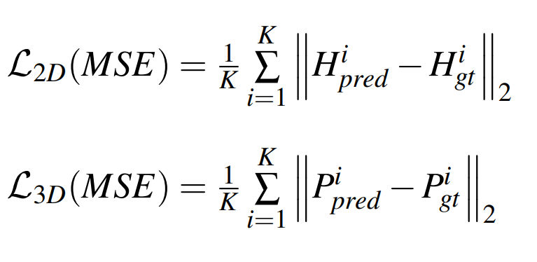
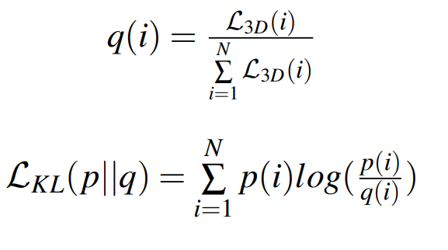
Loss function
2D stacked hourglass model
Used for 2D joint heatmap
3D regression model
Used for 3D joint prediction
Loss prediction model
Scaled loss as ground-truth
Notations
K: number of joints, i: the i-th joint
H: 2D heatmap, P: 3D coordinate
N: batch size
scaled 講法要順一點
normalize 在related work就要講

Slide 36
Overview
Training stage
Query top-2K data
Query top-2K data
2D pose model
3D pose model
Loss prediction
module
Labeled data
Loss prediction
module
Active learning
Labeled 2D feature
δ
Labeled data
2D pose model
Relevant
score
Unlabeled 2D feature
Core-Set
Unlabeled subset
Unlabeled data

Slide 37
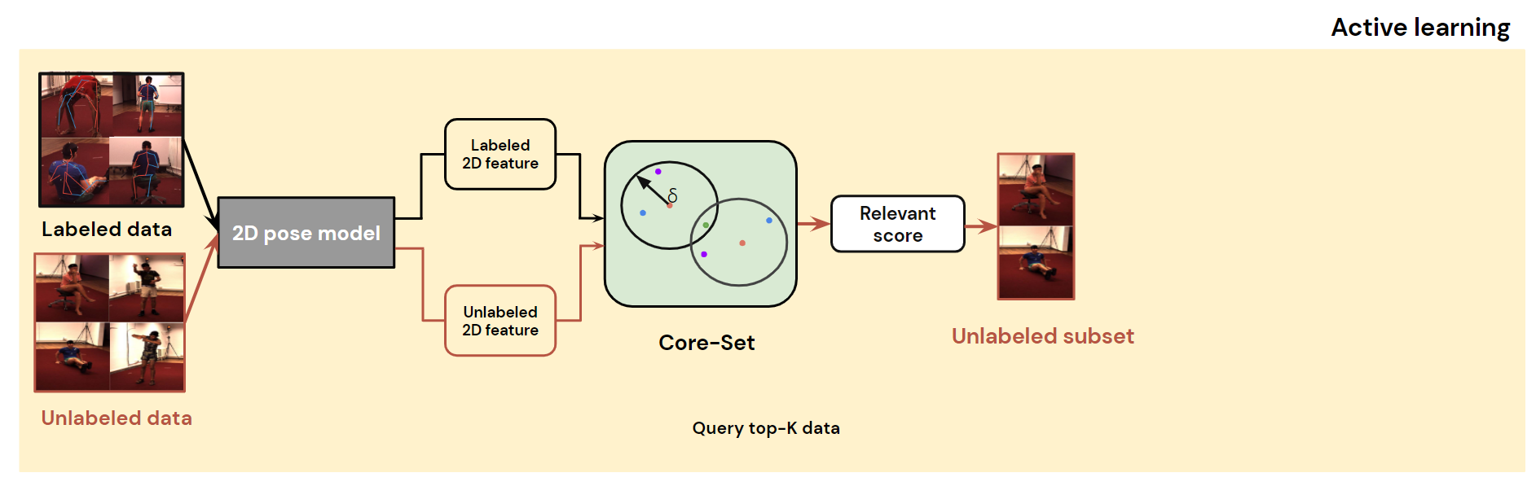
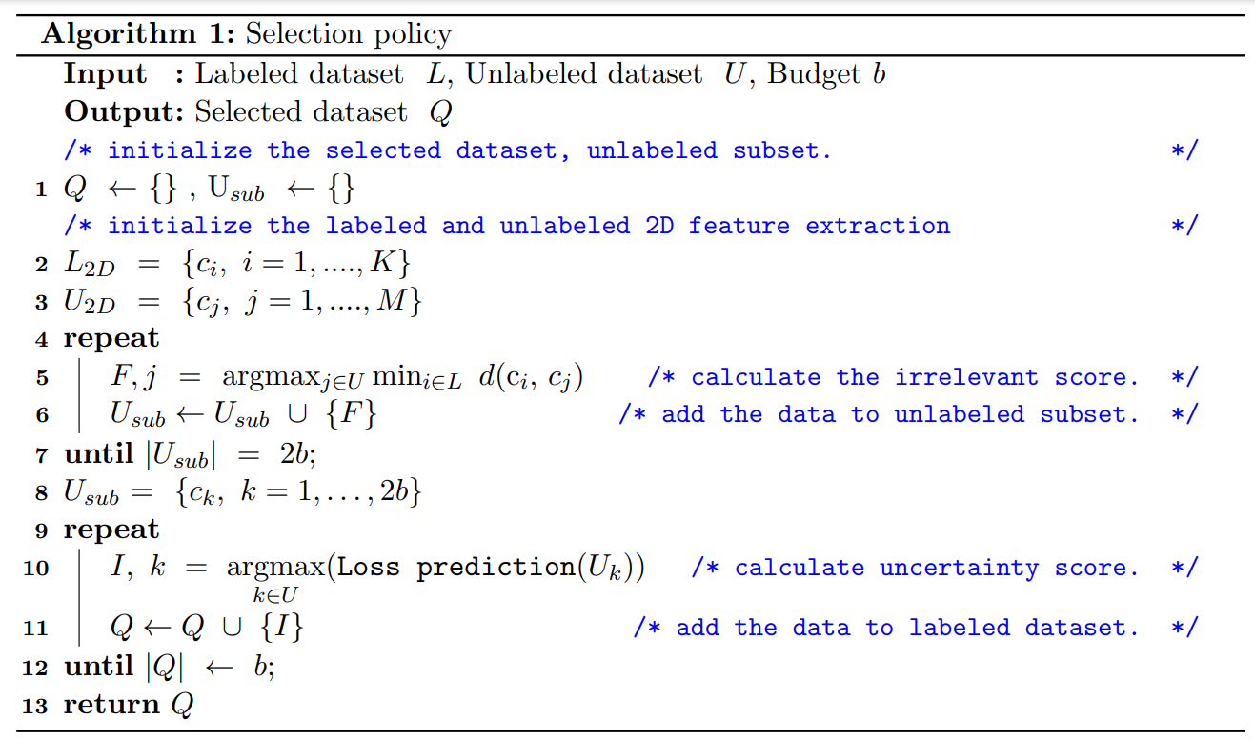
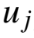
Active learning - Relevant Score
Apply Core-Set algorithm on 2D feature as relevant score.
Labeled data as center
Given threshold(delta)as radius
δ

Slide 38
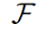
Active learning - Relevant Score
Apply Core-Set algorithm on 2D feature as relevant score.
u2
C1
u5
u1
u4
C2
u3

Slide 39
Active learning - Relevant Score
Apply Core-Set algorithm on 2D feature as relevant score.
Pick the most informative data points
u2
C1
u5
u1
u4
C2
u3

Slide 40
Active learning - Relevant Score
Apply Core-Set algorithm on 2D feature as relevant score.
u2
C1
3
u5
u1
4
u4
C2
u3

Slide 41
Active learning - Relevant Score
Apply Core-Set algorithm on 2D feature as relevant score.
u2
C1
3
u5
u1
4
u4
C2
u3

Slide 42
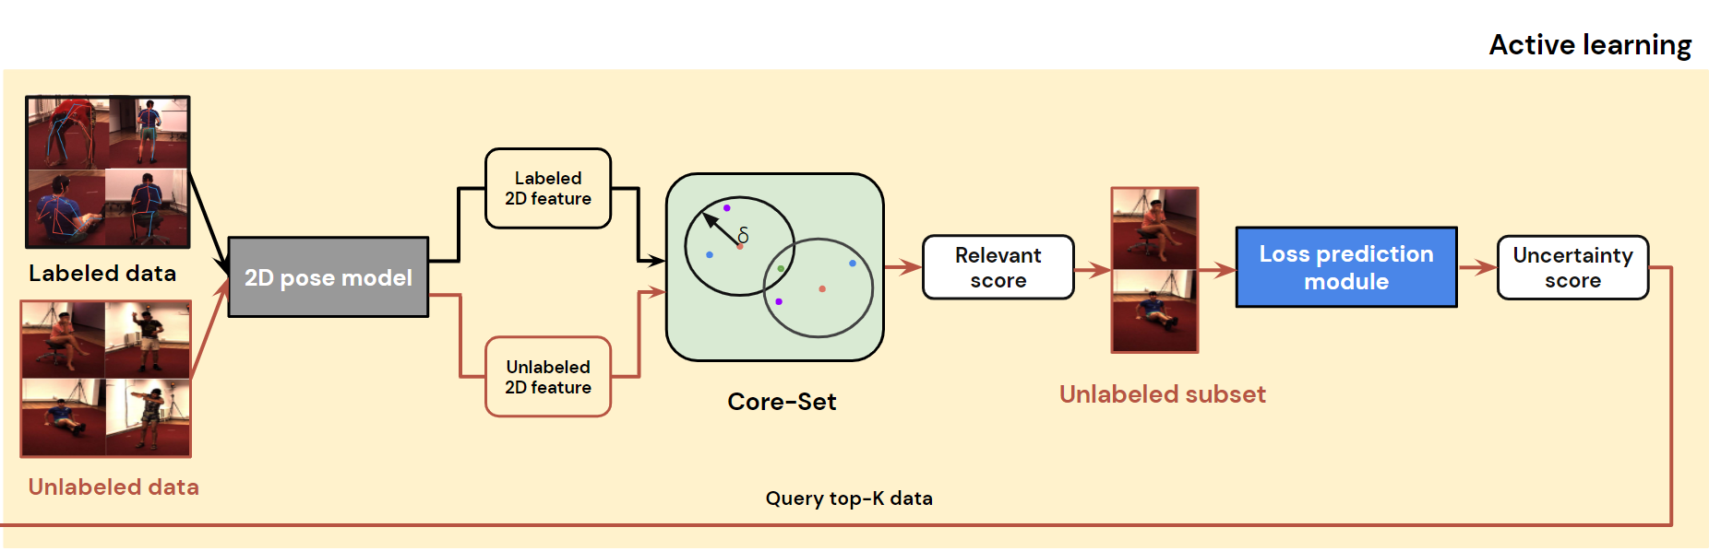
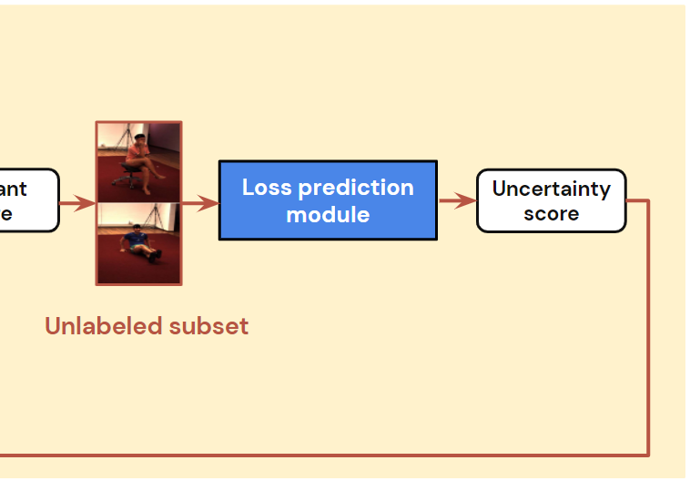
Active learning - Uncertainty Score
Evaluate loss prediction module with unlabeled subset.
Loss prediction
module
Uncertainty
Score
Unlabeled subset

Slide 43
Overview
Training stage
Query top-2K data
Query top-2K data
2D pose model
3D pose model
Loss prediction
module
Labeled data
Diversity: relationship between labeled data and unlabeled data
Uncertainty: relationship between task model and unlabeled data
Loss prediction
module
Active learning
Labeled 2D feature
δ
Labeled data
2D pose model
Relevant
score
Loss prediction
module
Uncertainty
score
Unlabeled 2D feature
Core-Set
Unlabeled subset
Unlabeled data
Query top-K data

Slide 44
Overview
Training stage
Query top-2K data
Query top-2K data
2D pose model
3D pose model
Loss prediction
module
Labeled data
Diversity: relationship between labeled data and unlabeled data
Uncertainty: relationship between task model and unlabeled data
Loss prediction
module
Active learning
Switch
Labeled 2D feature
δ
Labeled data
2D pose model
Relevant
score
Loss prediction
module
Uncertainty
score
Unlabeled 2D feature
Core-Set
Unlabeled subset
Unlabeled data
Query top-K data

Slide 45
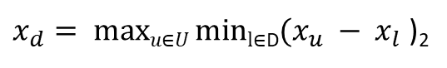
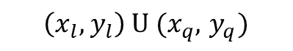



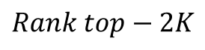
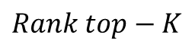

Data Flow
The blue line
Represents the stage of training three model parameters.
Optimizes target loss and loss-prediction loss.
The red line
Represents the query strategy.
Samples the Informative-rich and representative data.
The output of the multiple hidden layers of the DL model is used as the input of the loss prediction module, while the top-𝐾 unlabeled data points are selected according to the predicted losses and assigned labels by the oracle
A schematic diagram of unlabeled dataset and labeled dataset
All the model is fixed weight.
Each cycle selects K data, until run out of budget b.
Labeled dataset
2D model
3D model
3D model
(Labeled) 2D feature extraction
(Unlabeled) 2D feature extraction
(Labeled) 3D feature extraction
(Unlabeled) 3D feature extraction
Core-Set
Loss prediction
module
Unlabeled dataset
Labeled data flow
Unlabeled data flow
Diversity score Xd
Uncertainty score Xp
Unlabeled subdataset
Budget b

Slide 46
Experiments setup
Quantitative Results
Ablation Study
Query pattern
Experimental Results

Slide 47
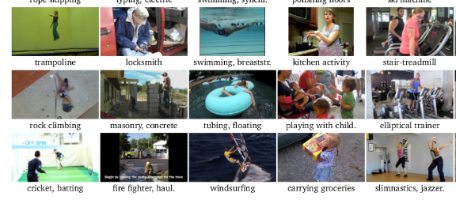
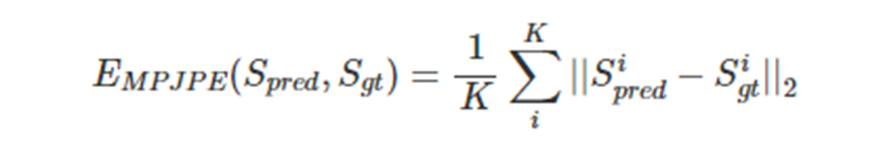
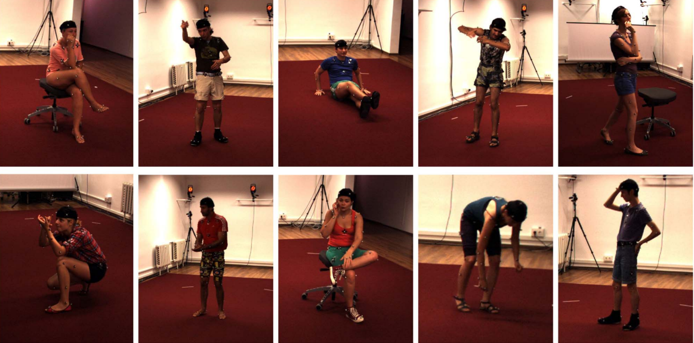

Datasets
MPII Human Pose (2D dataset)
Training set: 28,821 images
Testing set: 2958 images
Human 3.6M (3D dataset)
Training set: 35823 images
Testing set: 1932 images
Evaluation Metric
MPJPE (Mean Per Joint Position Error)
L2 distance averaged over all joints

Slide 48
Scenario
Active learning
Labeled dataset: MPII
Unlabeled dataset: H36M
Training stage
Fixed 2D pose model, retrain 3D pose and loss prediction model.
Training dataset (2D model) | Training dataset (3D model)
MPII | H36M
MPII | H36M(*AL)
(*AL): query data with active learning approach.

Slide 49
Implementation Details - Active learning
 | # of images
Initial stage (Stage 0) | 2000 images (5.58%)
Each stage | 2000 images (5.58%)
Stage 1 | 4000 images (11.17%)
Stage 2 | 6000 images (16.75%)
Stage 3 | 8000 images (22.33%)
Stage 4 | 10000 images (27.92%)
Total number of training dataset | 35822 images (100%)
Training stage | 3D pose model Loss prediction module
Active learning consists of four stages
Initial stage (Stage #0)
Randomly sample 2000 images.
Each stage (Stage #1 ~ #4)
Selection policy selects 2000 images.

Slide 50

Quantitative Results - Active learning results
Analyze the performance of active learning results
For each active learning method, we repeat three times to obtain
average performance
standard deviation
x-axis: number of labeled dataset.
y-axis: task model performance on testing set (MPJPE, lower is better).
Baseline
Random
Core-Set (diversity)
Learning Loss (3D-based) (uncertainty)
Ours (A): Core-LL-Pose3D (hybrid)
Ours (B): LL-Core-Pose3D (hybrid)

Slide 51
Quantitative Results - Stage 1 & 2
Analyze the performance of active learning results
Hybrid strategies outperform other active learning methods at stage 1 & 2.
Our strategies have significantly performance with small training dataset.
Method | MPJPE(mm) with labeled dataset
 | 2000/Stage 0 | 4000/Stage 1 | 6000/Stage 2 | 8000/Stage 3 | 10000/Stage 4
Random | 117.71 | 111.36 | 109.51 | 108.32 | 106.46
Core-Set | 117.71 | 111.81 | 108.89 | 108.14 | 106.96
Learning Loss (3D) | 117.71 | 110.59 | 108.54 | 106.83 | 106.20
Core-LL-Pose3D | 117.71 | 109.71 | 108.43 | 107.13 | 106.65
LL-Core-Pose3D | 117.71 | 110.49 | 108.17 | 107.01 | 106.34

Slide 52
Quantitative Results - Stage 3 & 4
Analyze the performance of active learning results
Learning Loss(3D) (best) > LL-Core-Pose3D (second-best) at stage 3 & 4.
While increasing the training dataset
Uncertainty-based method has better performance.
Method | MPJPE(mm) with labeled dataset
 | 2000/Stage 0 | 4000/Stage 1 | 6000/Stage 2 | 8000/Stage 3 | 10000/Stage 4
Random | 117.71 | 111.36 | 109.51 | 108.32 | 106.46
Core-Set | 117.71 | 111.81 | 108.89 | 108.14 | 106.96
Learning Loss (3D) | 117.71 | 110.59 | 108.54 | 106.83 | 106.20
Core-LL-Pose3D | 117.71 | 109.71 | 108.43 | 107.13 | 106.65
LL-Core-Pose3D | 117.71 | 110.49 | 108.17 | 107.01 | 106.34

Slide 53

Quantitative Results - Random .vs. Ours
Analyze the performance of active learning results
Comparison of our methods and random selection.
With narrow standard deviation -> Robustness is better.
Data selection by our active learning
Stage 1 -> - 1.65 (mm)
Stage 2 -> -1.35 (mm)
Stage 3 -> -1.31 (mm)
Stage 4 -> -0.12 (mm)
Method | MPJPE(mm) with labeled dataset
 | 2000/Stage 0 | 4000/Stage 1 | 6000/Stage 2 | 8000/Stage 3 | 10000/Stage 4
Random | 117.71 | 111.36 | 109.51 | 108.32 | 106.46
Core-LL-Pose3D | 117.71 | 109.71 | 108.43 | 107.13 | 106.65
LL-Core-Pose3D | 117.71 | 110.49 | 108.16 | 107.01 | 106.34

Slide 54

Ablation Study
Three different types of loss prediction modules.
2D-based feature extraction from 2D model.
3D-based feature extraction from 3D model.
(2D+3D)-based feature extraction from both 2D and 3D model.
Method | MPJPE(mm) with labeled dataset
 | 2000/Stage 0 | 4000/Stage 1 | 6000/Stage 2 | 8000/Stage 3 | 10000/Stage 4
Learning Loss (2D) | 117.71 | 111.20 | 110.01 | 108.98 | 107.57
Learning Loss (3D) | 117.71 | 110.59 | 108.54 | 106.83 | 106.20
Learning Loss (2D+3D) | 117.71 | 110.08 | 108.61 | 107.67 | 107.17

Slide 55

Quantitative Results
Save up to 33.29% of labeling efforts while reaching the same performance.

Slide 56

Qualitative Results - Query pattern
t-SNE visualization
We investigate the relationship between selected dataset, labeled dataset and unlabeled dataset.
Comparison between different AL methods
Stage 1
Stage 1 -> Stage 4

Slide 57





Qualitative Results - Query pattern
Random
MPE
Learning Loss
Stage 1
Core-Set
Core-LL-Pose3D
LL-Core-Pose3D

Slide 58
Qualitative Results - Query pattern
Random
MPE
Learning Loss
Stage 1
Core-Set
Core-LL-Pose3D
LL-Core-Pose3D
Notes:
第一次結果
coreset: 2D fixed住 labeled data太少?
Uncertainty相關的都會散散的
mix, coreset 會分散且clustering在四周
在前期都會比較不太準確一點(因為資料量太少)
在後期會隨著資料量變多，每個AL選擇的特性會比較明顯一點
不用改是因為2D是fixed 住的
不管哪個stage 2D 模型都沒有改變

Slide 59






Stage 1
Stage 2
Stage 3
Stage 4
Core-Set
MPE

Slide 60
Unlabeled: 31822
Labeled: 2000
Selected: 2000
Unlabeled: 29822
Labeled: 4000
Selected: 2000
Unlabeled: 27822
Labeled: 6000
Selected: 2000
Unlabeled: 25822
Labeled: 8000
Selected: 2000
Core-Set
MPE

Slide 61



Unlabeled: 31822
Labeled: 2000
Selected: 2000
Unlabeled: 29822
Labeled: 4000
Selected: 2000
Unlabeled: 27822
Labeled: 6000
Selected: 2000
Unlabeled: 25822
Labeled: 8000
Selected: 2000
Core-Set
Learning Loss

Slide 62



Unlabeled: 31822
Labeled: 2000
Selected: 2000
Unlabeled: 29822
Labeled: 4000
Selected: 2000
Unlabeled: 27822
Labeled: 6000
Selected: 2000
Unlabeled: 25822
Labeled: 8000
Selected: 2000
Core-Set
Core-LL-Pose3D

Slide 63



Unlabeled: 31822
Labeled: 2000
Selected: 2000
Unlabeled: 29822
Labeled: 4000
Selected: 2000
Unlabeled: 27822
Labeled: 6000
Selected: 2000
Unlabeled: 25822
Labeled: 8000
Selected: 2000
Core-Set
LL-Core-Pose3D

Slide 64
Conclusion
&
Future Work
Conclusion
Future work

Slide 65
Conclusion
We design an active framework combining uncertainty and diversity for 3D human pose estimation.
Quantitative results
Hybrid strategy outperforms other existing active learning methods with small dataset.
Robustness is better.
Qualitative results
The query pattern to observe different active learning selection results.

Slide 66
Future Work
Training stage
Replace 2D and 3D models with SOTA pose models.
Active learning (Selection policy)
Dynamic weighted.
Apply on different scenario
Create new 3D dataset(MPI3D) based on existing public 3D dataset(Human 3.6M)
Scenario | Training dataset (2D model) | Training dataset (3D model)
Current work | MPII | H36M
 | MPII | H36M(*AL)
Future work | MPII+H36M+MPI3D | H36M+MPI3D
 | MPII+H36M+MPI3D(*AL) | H36M+MPI3D(*AL)

Slide 67
Thank you for your attention
Notes:
謝謝各位委員

